Slide 1
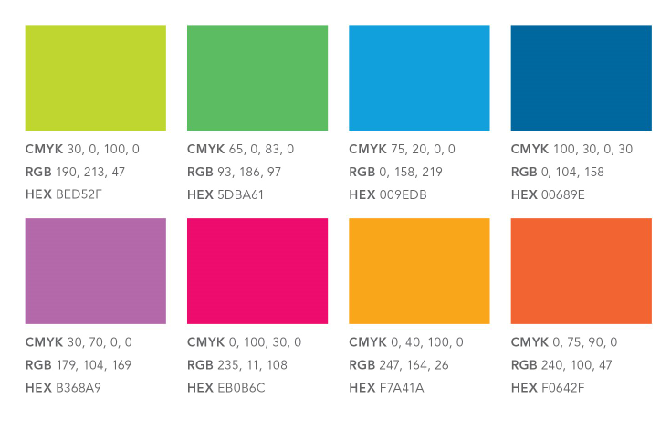
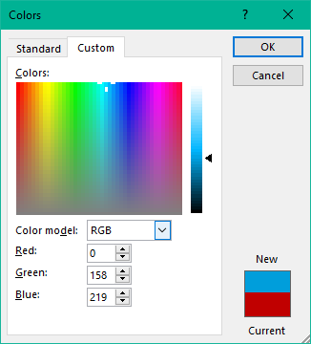
PLANNING GUIDE:
Delete slides you do not need, and copy any slides you want multiples of
Want to add some graphics? Look here: https://www.dropbox.com/sh/2wt2pmshs48vodo/AADU9X2G380UBsPFc0QB6tS_a?dl=0
Use Edmentum branded colors:
Keep in mind… less is more when it comes to making a visual impact. Don’t overdo it on the colors and graphics or your presentation could look more like Lisa Frank than Edmentum.
1. Select ‘font color’ and ‘More colors’
2. Toggle to ‘Custom’ and enter the RGB code

Slide 2
Technical Integration Solutions

Slide 3
Who We Are
We are committed to making it easier for educators to individualize learning for every student through:
1
Digital curriculum that is rigorously aligned to state standards, and used in blended and virtual learning environments.
Digital Curriculum
Proven Assessments
2
Assessments supported by strong validity and reliability, used for classroom practice, formative assessment, and benchmarking.
3
Managed services and consulting for comprehensive program design, implementation, support, and evaluation.
Educational Consulting

Slide 4
Technical Integration Solutions
Edmentum offers a variety of integration capabilities including SIS, LTI, API, and SSO solutions. We will work with you to determine which integration solutions fit your district or school best.
Integration solutions include:
Automated data management to ensure your users are up to date in Edmentum’s systems
A central point of control for your district to manage all user enrollments
A simplified way to launch and access all content and activities in your host LMS
Account set up, training, and ongoing support from Edmentum’s technical consultants

Slide 5
Learning Tools Interoperability (LTI)
Providing the flexibility you need to integrate Edmentum solutions with the Learning Management System (LMS) you already have in place.
LTI standard compliance allows us to easily share content and courses with any LTI 1.1 or 1.2 certified LMS
Browse, create, run, and manage our solutions at an individual module level throughout your LMS
Provide a familiar, streamlined experience for your students and save time for teachers
Reflect student progress in Edmentum courses through your LMS
Full support is provided for all LTI-compliant systems, including these widely used providers:
Note: LTI is available for Courseware only.

Slide 6
Student Information System (SIS)
Automatic data synchronization with your SIS is an important component to ensuring a seamless implementation.
Automate time-consuming data entry and administration tasks
Sync critical data including student and teacher records, location changes, and user activations automatically
Create and roster class sections based on schedule and add or move students as needed
Our secure SIS integration partners:
Note: SIS integration via Clever is available for Courseware, Edmentum Assessments, Exact Path, and Study Island. SIS Integration via Classlink is available for Courseware, Exact Path, and Study Island.

Slide 7
Single Sign-On (SSO)
Students and teachers can easily log in to select Edmentum products leveraging our SSO partnerships.
SSO is a user authentication service that permits your students and teachers to use one set of login credentials to access multiple applications.
Overcome login credential confusion and keep the classroom focused on teaching and learning
SSO is available for the following widely used systems:
Note: Clever is available for Courseware, Edmentum Assessments, Exact Path, and Study Island. Classlink is available for Courseware, Exact Path, Study Island. Google for Education and Microsoft Office 365 Education SSO integrations are only available for EducationCity.

Slide 8
Application Programming Interface (API)
Your team can create an application that allows your SIS to communicate with our solutions.
When a student is created or updated in your SIS, that student is automatically created or updated in our systems—no manual reentry of data needed.
Our API package includes the following:
Based on REST (representational state transfer) architecture
JSON and XML capable
Manage users, classrooms, assignments
Note: Currently available for Courseware and Edmentum Assessments.

Slide 9
Technical Support
Our team of technical consultants will support your implementation.
Integration solutions include:
Planning and project management guidance
Initial test environment
Technical documentation and transition training
Setup of test and production accounts
An integration entry point with credentials
Ongoing support throughout the life of your account

Slide 10
Dedicated to Data Integrity
Compliance with relevant technology, interoperability, and student privacy standards is our priority.
We recognize Edmentum programs may play only a small role in the complex ecosystem of your school or district. It’s our goal to make our solutions fit into your unique ecosystem seamlessly, safely, and conveniently.
Edmentum supports the following organizations and initiatives dedicated to data integrity:
Project Unicorn Coalition
Student Privacy Pledge
CoSN
IMS Global

Slide 11
Q&A

